Slide 1

MONOJO Biotech
Services Centre

Slide 2
Introduction & Background
MonoJO Biotech is a distinguished biotech company in the Middle East, established in 2005 by Penelope Shihab.

Slide 3

Our Vision
To become a world class multi-functional biotechnology platform that provides a wide range of research services and medical innovations.
Our Mission
MonoJO aims to transfer its applied research in biotechnology to serve the world with unique medical products that have a major impact on people’s lives, worldwide environment, and economic well-being.

Slide 4
Science at MonoJO
At MonoJO, Science is our core business. Our scientists work at the forefront of biotechnology research and collaborate with global experts to discover and develop therapies inspired from nature.

Slide 5
MonoJO’s Laboratories
MonoJO’s Laboratory is fully equipped to conduct a wide range of physical, microbial, biological and chemical testing needed for all healthcare sectors. including :
1. Food sector
2. Pharmaceutical sector
3. Cosmetic and medical devices sector
Moreover our laboratory is ISO 17025 certified by JAS for a list of Microbial, Physical and Biological tests.

Slide 6
Services for Food Sector
MonoJO is providing the food sector with the following services

Slide 7
Food testing
1. All type of Microbial testing for the Raw, Finished products as well as testing the Ro-water
2. All type of Physical testing
3. Many type of chemical testing
4. Halal testing for any food product.

Slide 8
Diary Sector services
Service department at MonoJO offers solutions that tackle major diary sector problems, starting from Animal health, raw milk and finally Milk-Based products.
MonoJO’s food services includes:
- Animal Feeding Testing.
- Raw Milk Testing.
- Infectious Diseases Diagnosis (DNA and Protein Levels).
- Bovine Hormones Detection and Quantification.
- Bovine Minerals Quantification.
- Halal testing by PCR validated method

Slide 9
food sector Consultation
1. Customized testing for any special case.
2. Method development of any related cases in the R&D
3. Micro Lab contracts and training.

Slide 10
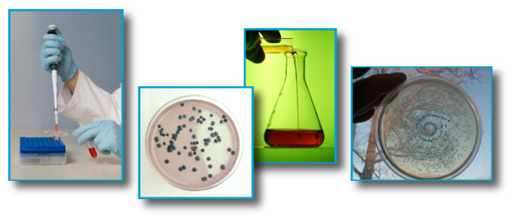
Cosmetic Services & Testing Services
MonoJO is considered a main provider for the following services for the cosmetic sector:
1. Formulation development.
2. Microbial and contamination Testing.
3. Preservative Challenge Testing.
4. Cosmetics Safety and Efficacy Testing.
5. Stability Studies.
6. Active ingredient analysis.

Slide 11
Other Services
Also MonoJO is providing services for the following sectors :
1. Biotech and Pharmaceutical services
2. training services for the pharma, Biotech and other healthcare
3. regulatory consultations

Slide 12
thank you khaled khraisat kkhraisat@monojo.com.jo

